Slide 1
Quality health plans & benefits
Healthier living
Financial well-being
Intelligent solutions
2024 External Group Medicare
Broker Certification Instructions

Slide 2
The following pages provide step-by-step instructions for accessing the correct certification learning plan for those that sell Aetna Group Medicare business

Slide 3
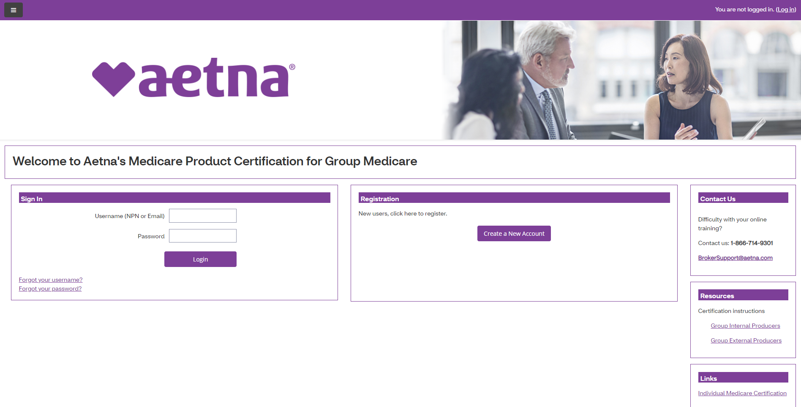
Log-in page EXISTING USER
Navigate to the Certification Portal at the following URL: https://aetnagroup.cmpsystem.com/
If you are a returning user, click on the “Forgot your password?” link to reset your password. Due to a few security enhancements, you must change your password to access the new site. You will be prompted to search for your account using your username or email address on record. An email will be sent to you with instructions on how to reset your password to access the new site.

Slide 4
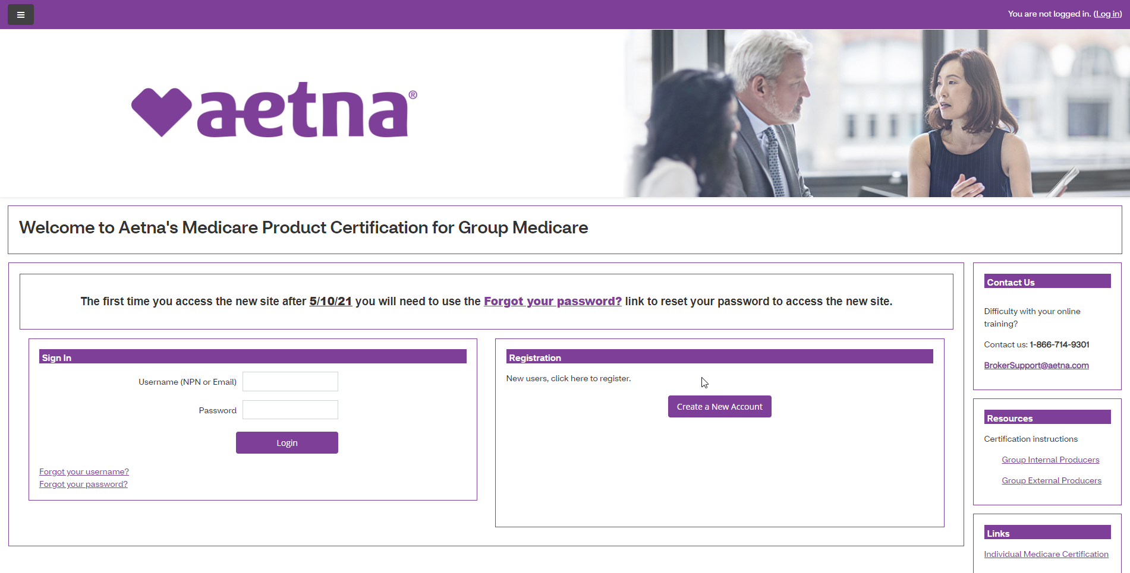
Log-in page NEW USER
Navigate to the Certification Portal at the following URL: https://aetnagroup.cmpsystem.com/
All new users are required to create a new account and complete profile information. Click the Create a New Account button

Slide 5
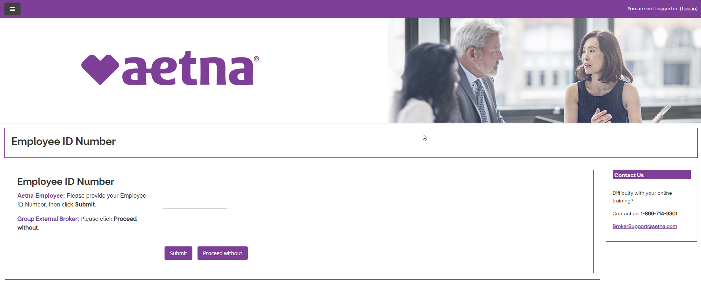
Log-in page NEW USER
As a Group Medicare producer external to Aetna, click on Proceed without and leave the other field blank

Slide 6
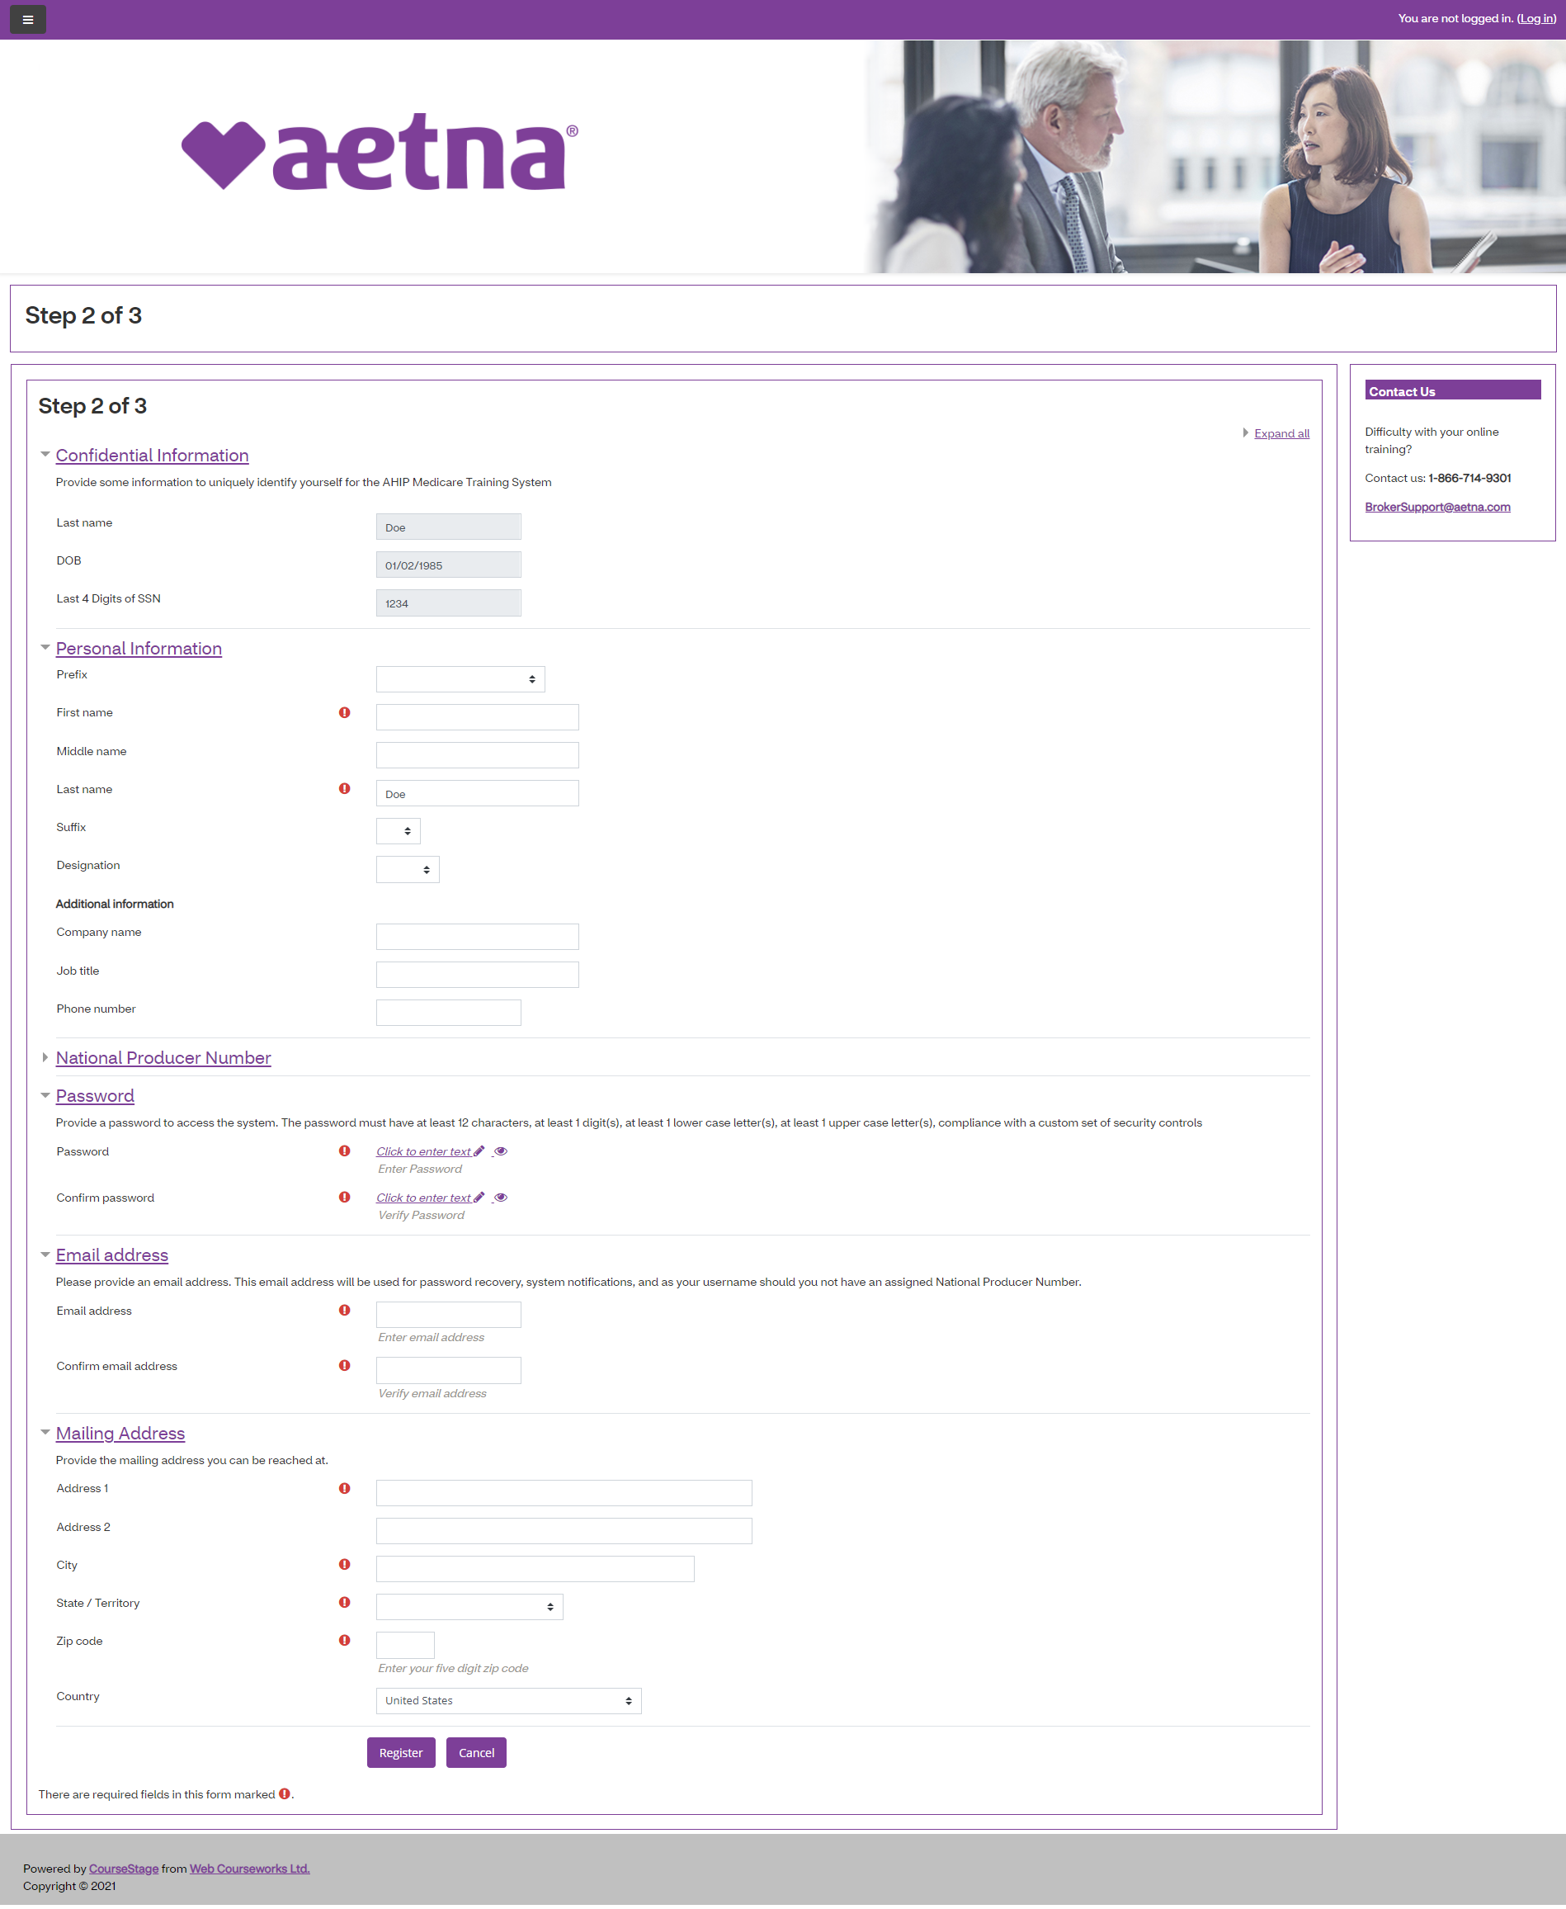
Log-in page NEW USER
You will be instructed to complete the Confidential Information where you will be required to enter you NPN and click the Submit button to start the registration process. You will then need to fill out a few demographic details and give your account a password.

Slide 7
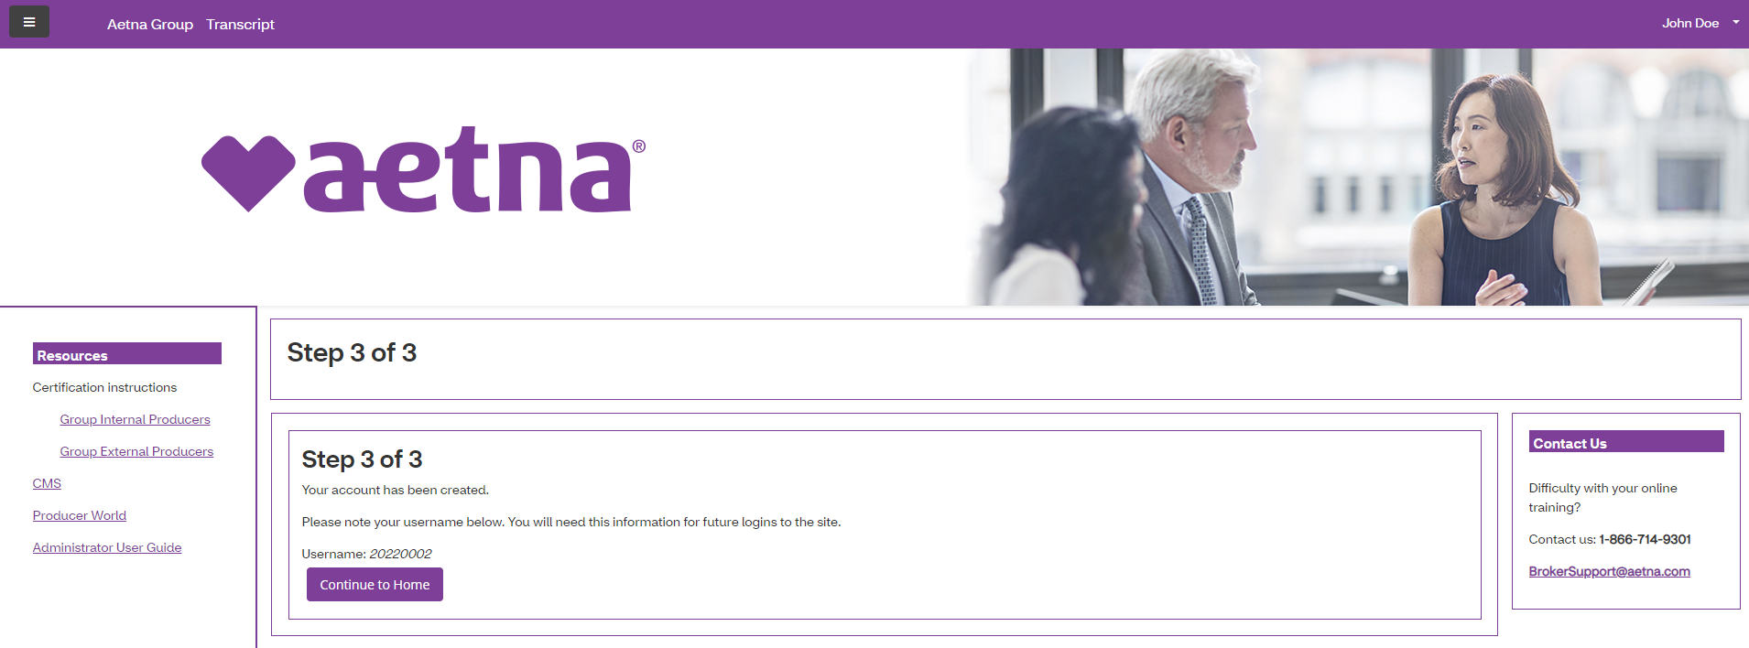
Log-in page NEW USER
Once you have registered for an account, you will be assigned a username. The username and password is your login for when you want to complete your Group Medicare Certification.
Click on the Continue to Home button. This will take you directly to the Aetna Certification homepage and you will be able to access your learning plan. The learning plan will be listed under My Certifications.

Slide 8
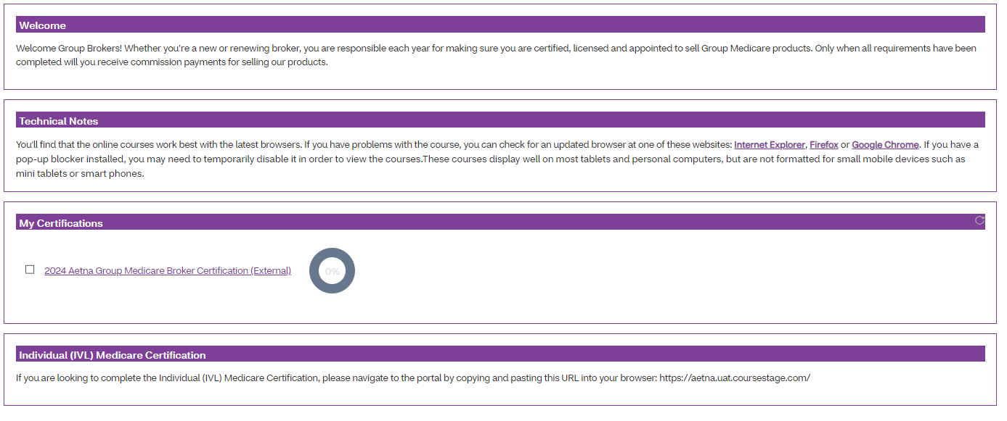
Certification Landing Page
This is the certification landing page where you will complete the 2024 Aetna Group Medicare Broker Certification learning plan under My Certifications

Slide 9
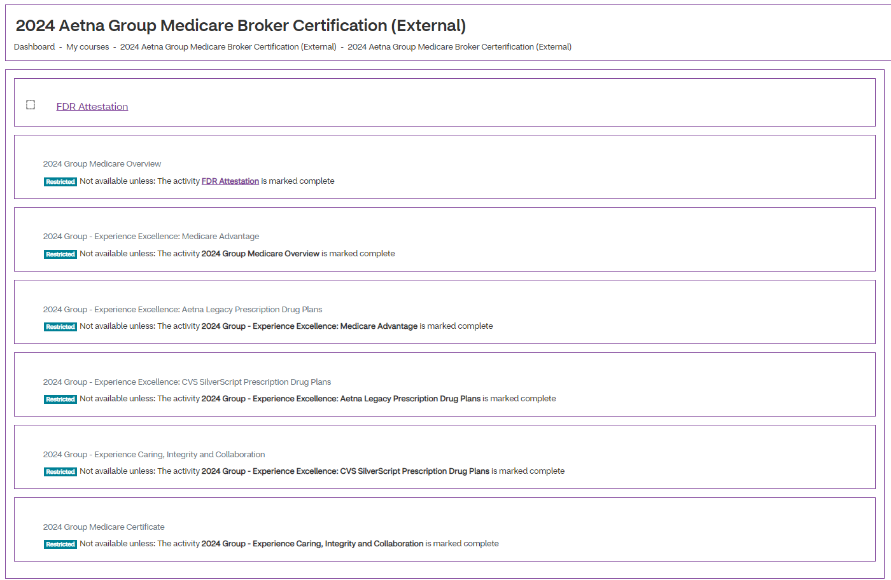
Certification Learning Plan
Things to note:
You cannot skip around; you are required to take the Learning Plan in the order listed
You do not have to complete the Learning Plan in one sitting. You will be able to return to where you left off
You must pass each mastery test with a score of 90 or above in three attempts
Mastery tests are housed within the corresponding modules. Complete the course before the mastery tests becomes available to attempt.
When you complete your certification and pass, you will receive a confirmation email.
Once you have completed the learning plan, your certificate will be available for download. Please keep a copy of your certificate.

Slide 10
If you have any questions, please contact Broker Services Department at
1-866-714-9301 or BrokerSupport@aetna.com

